Slide 1
Seismic Detection Across the Solar System
Hana-Haneen-Menna

Slide 2
Introduction
Overview: This project uses machine learning to classify moonquake events based on seismic data collected during lunar missions.
Objective: Build a classification system to predict moonquake types using Transformer-based deep learning models.

Slide 3
Problem Statement
Why classify moonquakes?
understanding moonquake events helps in studying the lunar interior and aids in planning future lunar missions.
Challenges:
Limited data from lunar missions.
Complexity of time-series data.
Need for accurate classification models.

Slide 4
TABLE OF CONTENTS
01
02
03
OVERVIEW
Preprocessing
Model Architecture
04
05
06
Training the Model
Evaluation
Results

Slide 5
01
OVERVIEW

Slide 6
Dataset Overview
Data Source: Seismic data (CSV files with velocity and time).
Catalog linking files to moonquake types.
Columns in CSV files :
Velocity (m/s): Seismic velocity at specific time intervals.
Time (sec): Corresponding time for each velocity measurement.
Columns in CSV files : The catalog file includes different types of moonquakes (e.g., Moonquake_A, Moonquake_B).

Slide 7
Data Preprocessing
Feature Extraction:
Time-domain features (e.g., mean, standard deviation).
Frequency-domain features (FFT-based features).
Spectral features (e.g., spectrogram statistics)
Label Encoding:
Convert moonquake types to numerical values
Data Scaling:
Standardize features using StandardScaler to improve model training.

Slide 8
Model Architecture!
Model Type: Transformer Neural Network

Slide 9
Key Components:
Embedding Layer
Transformer Encoder
Fully Connected Layer
Positional Encoding
Converts raw input into a dense representation.
Learns dependencies in the data using self-attention.
Outputs the classification prediction.
Adds information about the temporal relationships of the data.

Slide 10
Why Transformer?:
Effective at handling sequential data and capturing long-term dependencies.

Slide 11
02
Transformer Architecture

Slide 12
TYPES OF NATURAL DISASTERS
Positional Encoding
Self-Attention Mechanism
Global Average Pooling
Introduces position-aware information into the model to preserve the sequence's temporal order.
Helps the model focus on relevant parts of the sequence when making predictions.
Reduces the output to a fixed-size vector, summarizing the sequence's information.

Slide 13
Data Preparation
Loading and Processing
Matching with Catalog
Use catalog entries to match seismic data with the moonquake types.
Pprocess CSV files containing velocity and time data.
Extract relevant features (time-domain, frequency-domain, and spectral).

Slide 14
Training the Model
Train-test split
Split the dataset into training and testing sets (80/20)
Batching
Model Training
Optimizer: Adam
Loss Function: Cross-Entropy Loss.
Training for multiple epochs (e.g., 50 epochs).
Data is loaded in batches to optimize memory and training time.

Slide 15
Evaluation & Result

Slide 16
Evaluation Metrics:
Sample Output:
Precision, Recall, F1-Score:
To evaluate classification performance
Confusion Matrix:
To visualize class prediction accuracy
A classification report showing the precision, recall, and F1-score for each moonquake class.

Slide 17
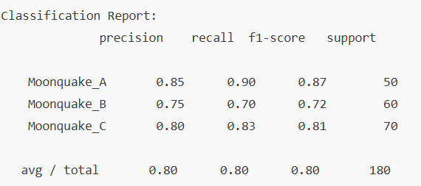
—Results

Slide 18
Summary:
The Transformer-based model effectively classifies moonquake events using seismic data.

Slide 19

Impact
This model can be used to analyze seismic data from future lunar missions and enhance our understanding of the moon's interior.

Slide 20

Future Directions
Explore different model architectures and optimize for deployment in real-time applications.

Slide 21

THANKS!
Do you have any questions?
Please keep this slide for attribution

